Slide 2
Using TypeScript in a big open source project
DEV221
David Catuhe
Senior Program Manager
DX

Slide 3
Confidentiality Slide

Slide 4
Session Objectives And Takeaways
Session Objective(s):
Understanding why you should consider using TypeScript instead of JavaScript
Understanding how you can port your existing JavaScript code to TypeScript
Use and understand how TypeScript works
Decide if TypeScript is the right language for your project
Notes:
This slide is required. Do NOT delete. This should be the first slide after your Title Slide. This is an important year and we need to arm our attendees with the information they can use to Grow Share! Please ensure that your objectives are SMART (defined below) and that they will enable them to go in and win against the competition to grow share. If you have questions, please contact your Track PM for guidance. We have also posted guidance on writing good objectives, out on the Speaker Portal (https://www.mytechready.com).
This slide should introduce the session by identifying how this information helps the attendee, partners and customers be more successful. Why is this content important?
This slide should call out what’s important about the session (sort of the why should we care, why is this important and how will it help our customers/partners be successful) as well as the key takeaways/objectives associated with the session. Call out what attendees will be able to execute on using the information gained in this session. What will they be able to walk away from this session and execute on with their customers.
Good Objectives should be SMART (specific, measurable, achievable, realistic, time-bound). Focus on the key takeaways and why this information is important to the attendee, our partners and our customers.
Each session has objectives defined and published on www.mytechready.com, please work with your Track PM to call these out here in the slide deck.
If you have questions, please contact your Track PM. See slide 5 in this template for a complete list of Tracks and TPMs.

Slide 5

What is Babylon.js?

Slide 6

Babylon.js is: An average of 1 version per month 28 contributors 33 releases 592 commits 14000+ lines of code More than 120 files of code More than 250 forks A bandwidth of 1 TB per month for the website 1.3GB (Code and samples)

Slide 7
Demo
3D for the web/ Github
Notes:
Project visual studio / Github

Slide 8
Why TypeScript ?

Slide 9
Because it is transparent for users

Slide 10
Demo
What does TypeScript generate?
Notes:
Avant / apres sur BABYLON.Color3

Slide 11
Because Babylon.js is an open source framework

Slide 12
Demo
Finding awful bugs
Notes:
lengthSquared dans Collider et demo dans vs avec la version TS

Slide 13
Because TypeScript is open source

Slide 14
Develop with TypeScript
Node.js
Eclipse
Sublime Text
WebStorm
Emacs
VI
Visual Studio 2012 / 2013
Notes:
http://www.typescriptlang.org/
http://www.typescriptlang.org/Playground/#tut=ex1

Slide 15
Because TypeScript is incredibly efficient with Visual Studio

Slide 16
Demo
Using Visual Studio 2013 Update 2 with TypeScript
Notes:
Combo
F12 sur une function
Intellisense
Debugger
Code map dans IE pour debugger
Properties windows sur le projet

Slide 17
Because TypeScript clearly simplifies your code

Slide 18
Demo
Handling inheritance This is not that
Adding properties
Notes:
Demo inheritance avec baseDispose sur stdMaterial.js
Gestion du this dans les callbacks (onPointerMove sur arcRotateCamera)
Properties in instancedMesh (visibility)

Slide 19
For the future…

Slide 20
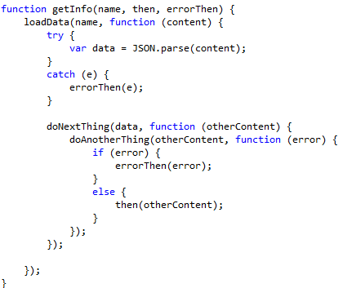
The promise / callbacks hell

Slide 21
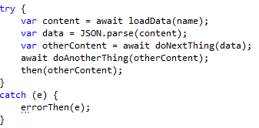
Can become just gorgeous…
Notes:
http://typescript.codeplex.com/wikipage?title=Roadmap&referringTitle=Home

Slide 22
How to port from JavaScript to TypeScript ?

Slide 23
From the ground up…

Slide 24
Demo
Porting Babylon.math.js
Notes:
Start porting Math.js

Slide 25
Don’t be afraid to mix things up

Slide 26
Demo
Current status of Babylon.js

Slide 27
Using interfaces and mixins

Slide 28
Demo
Babylon.mixins.ts

Slide 29
Call to actions
Official site:
http://www.TypeScriptlang.org/
Online playground:
http://www.TypeScriptlang.org/Playground
Source code:
http://TypeScript.codeplex.com/
Documentation:
http://TypeScript.codeplex.com/documentation

Slide 30
In Review: Session Objectives And Takeaways
Session Objective(s):
Understanding why you should consider using TypeScript instead of JavaScript
Understanding how you can port your existing JavaScript code to TypeScript
Use and understand how TypeScript works
Decide if TypeScript is the right language for your project
Notes:
This slide is recommended as a final slide to recap the objectives of the session to remind attendees what you said would be covered and to highlight that you did indeed cover those points. The objectives listed on this slide should match the objectives covered on the required Objective slide at the beginning of your presentation.
If you have questions, please contact your Track PM. See slide 5 in this template for a complete list of Tracks and TPMs.

Slide 31
Please Complete An Evaluation Form Your input is important!
Multiple ways to access Online Evaluation Forms:
CommNet stations located throughout conference venues
Via both TechReady Windows Phone and Windows 8.1 Event Apps
Via traditional TechReady Schedule Builder Windows Phone 7/8 Application
Via BYOD browser from any wired or wireless internet connection to https://www.MyTechReady.com
For more information, please refer to CommNet
Speaker – Click Here to Launch Video
Notes:
Speakers: The Launch Video button is not activated at this time. Please note this slide will be exchanged for the actual evaluation slide onsite when it will be linked to videos designed to encourage attendees to complete their evals. During your session, the evaluation video needs to be activated by you clicking on the launch video button on this slide.

Slide 32

© 2014 Microsoft Corporation. All rights reserved. Microsoft, Windows, and other product names are or may be registered trademarks and/or trademarks in the U.S. and/or other countries.
The information herein is for informational purposes only and represents the current view of Microsoft Corporation as of the date of this presentation. Because Microsoft must respond to changing market conditions, it should not be interpreted to be a commitment on the part of Microsoft, and Microsoft cannot guarantee the accuracy of any information provided after the date of this presentation. MICROSOFT MAKES NO WARRANTIES, EXPRESS, IMPLIED OR STATUTORY, AS TO THE INFORMATION IN THIS PRESENTATION.

